Slide 1
Design Document
PowerEnJoy Service
14/12/2016

Slide 2
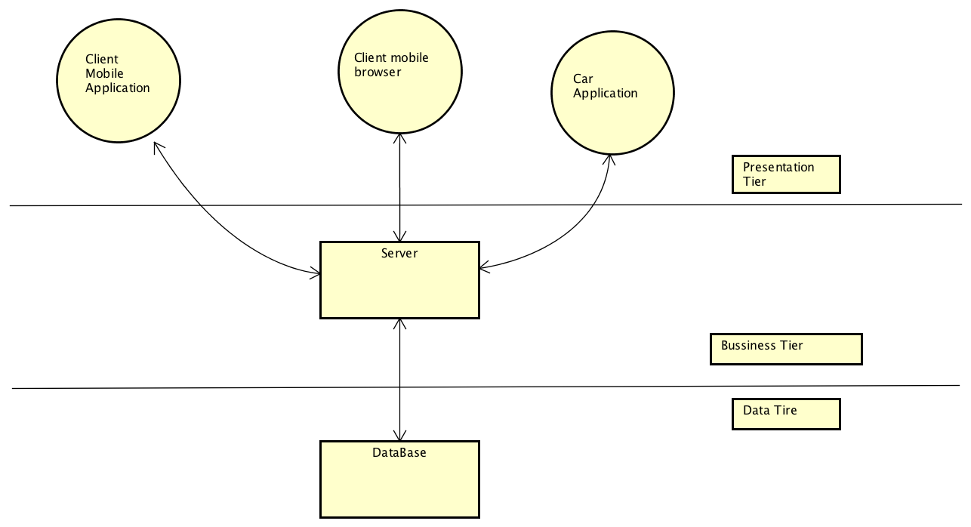
High Level Architecture
3 Tier - Presentation tier, Business tier, Data tier
MVC pattern ?

Slide 3
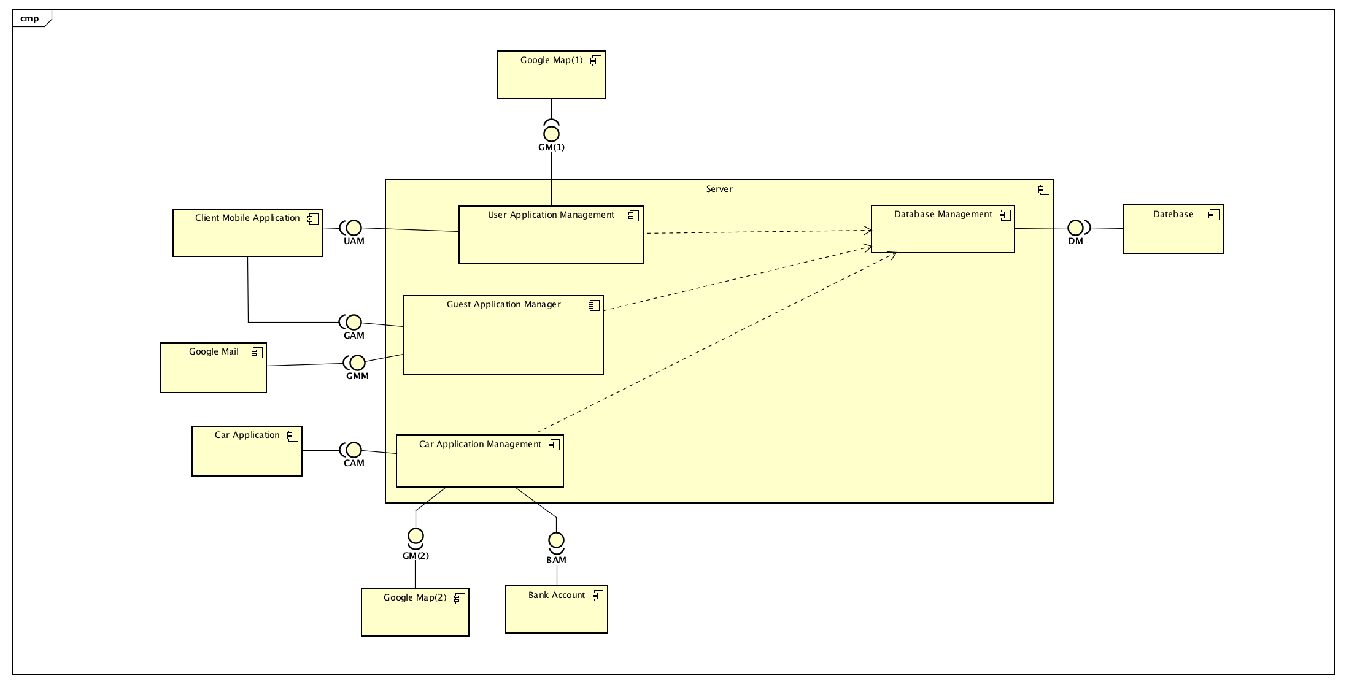
Component view
User Application Manager
Guest Application Manager
Car Application Manager
Database Manager

Slide 4
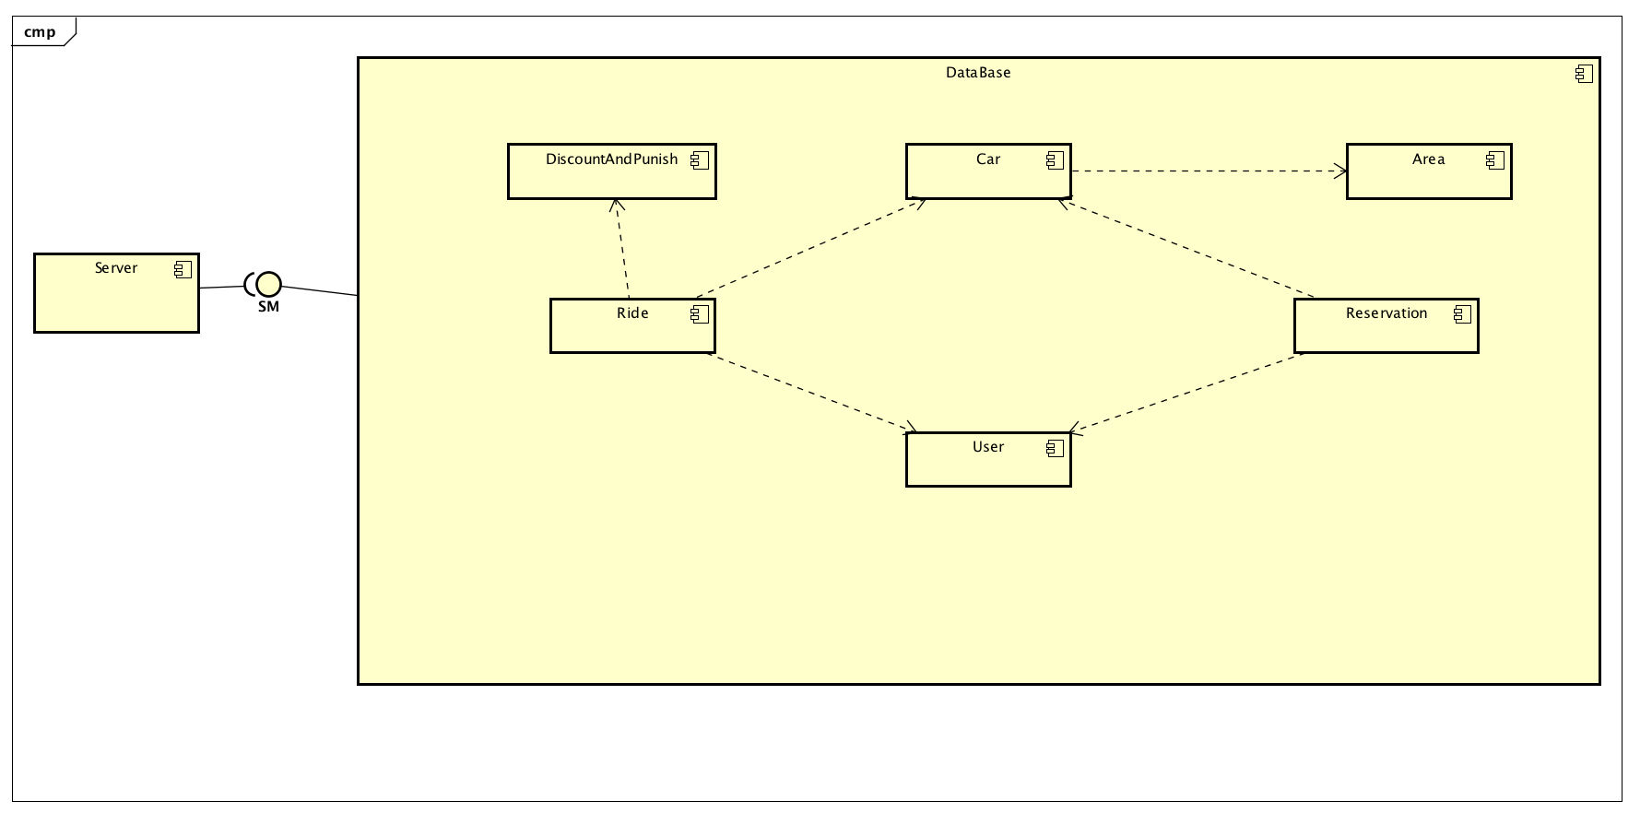

Slide 5
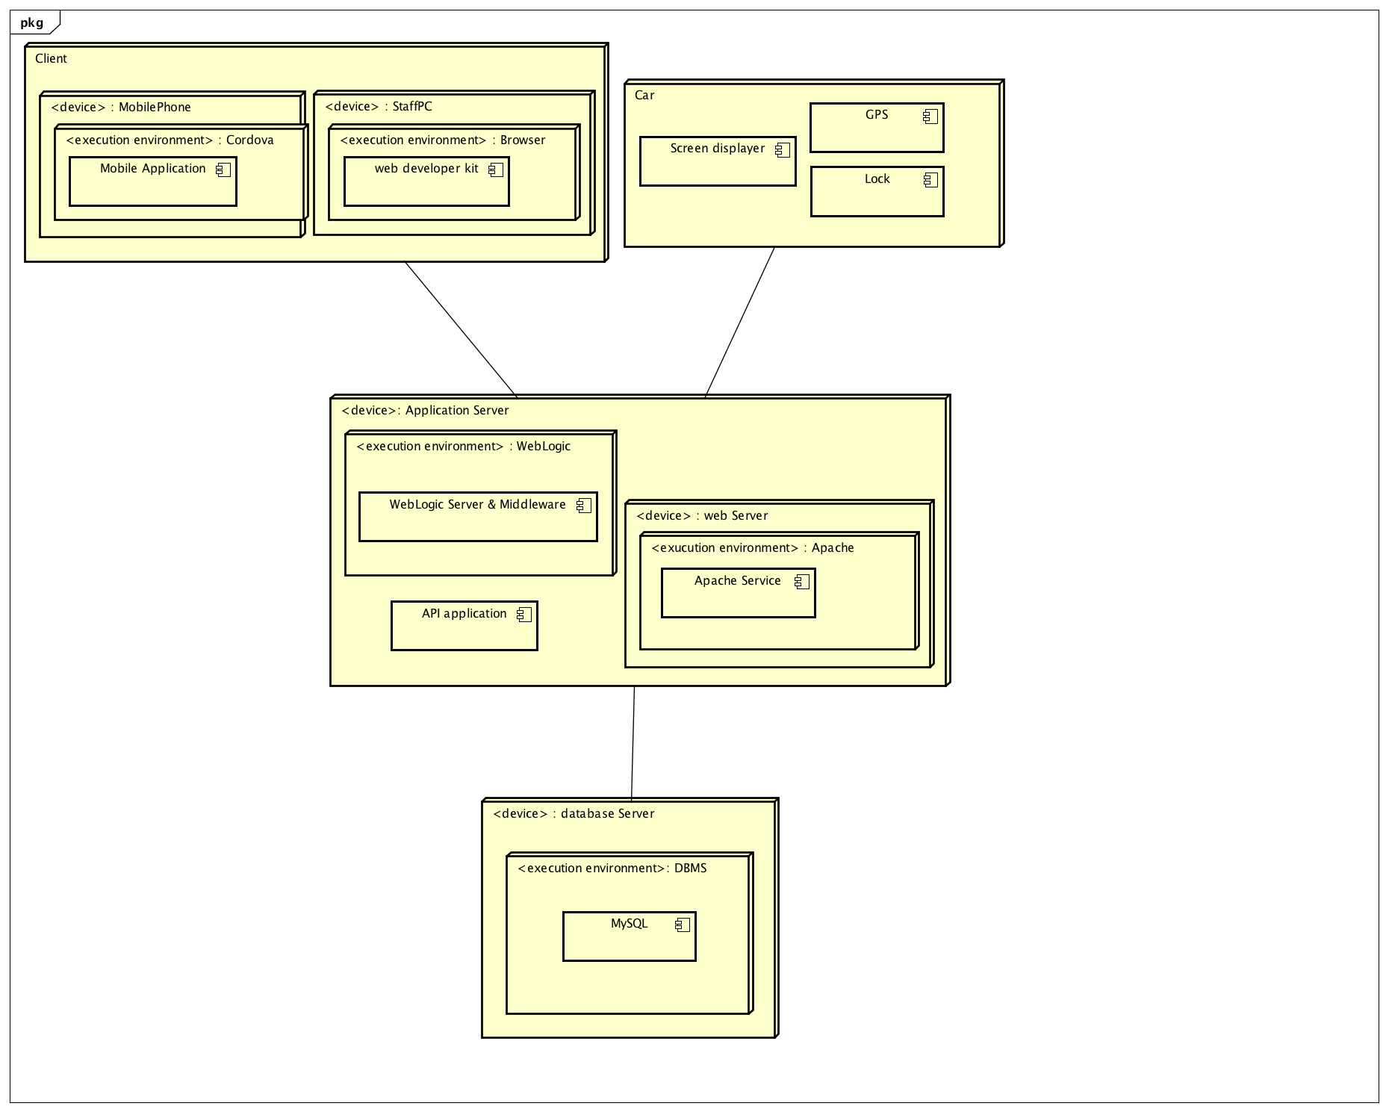
Deployment view

Slide 6
Runtime view
Register
Login
Reserve
OpenTheDoor
Renting

Slide 7
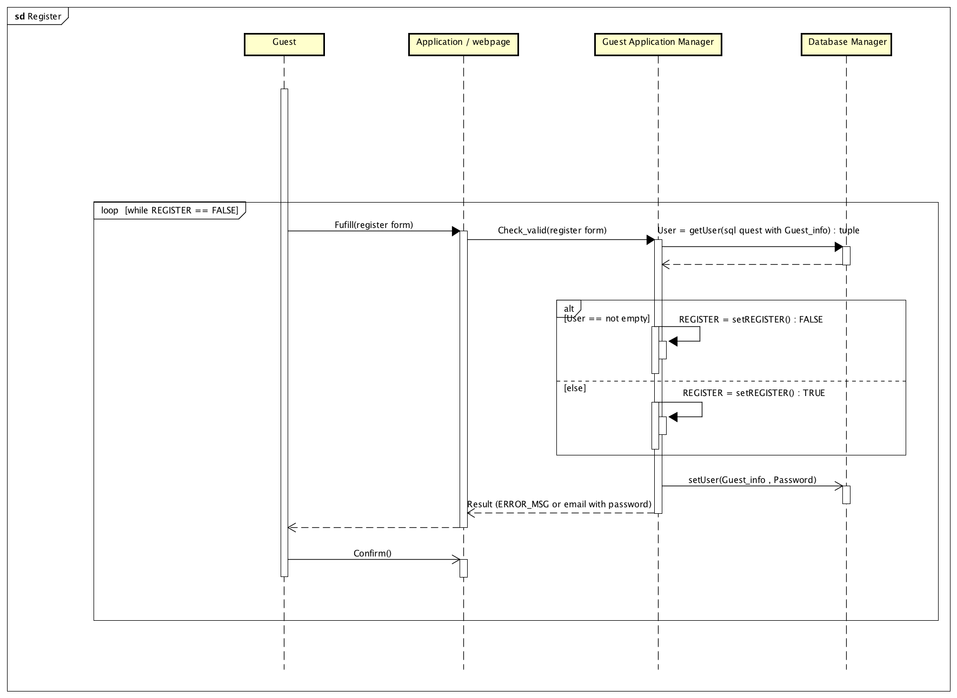
Register

Slide 8
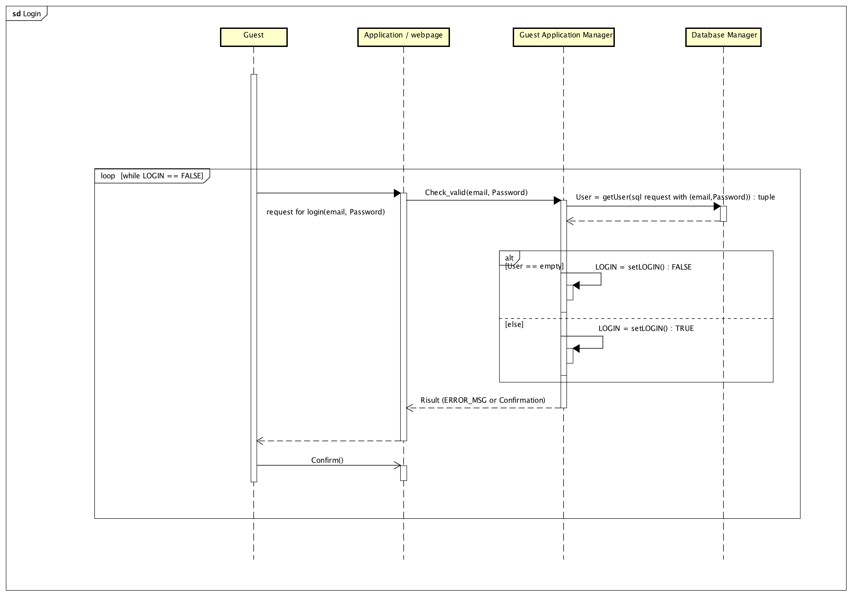
Log in

Slide 9
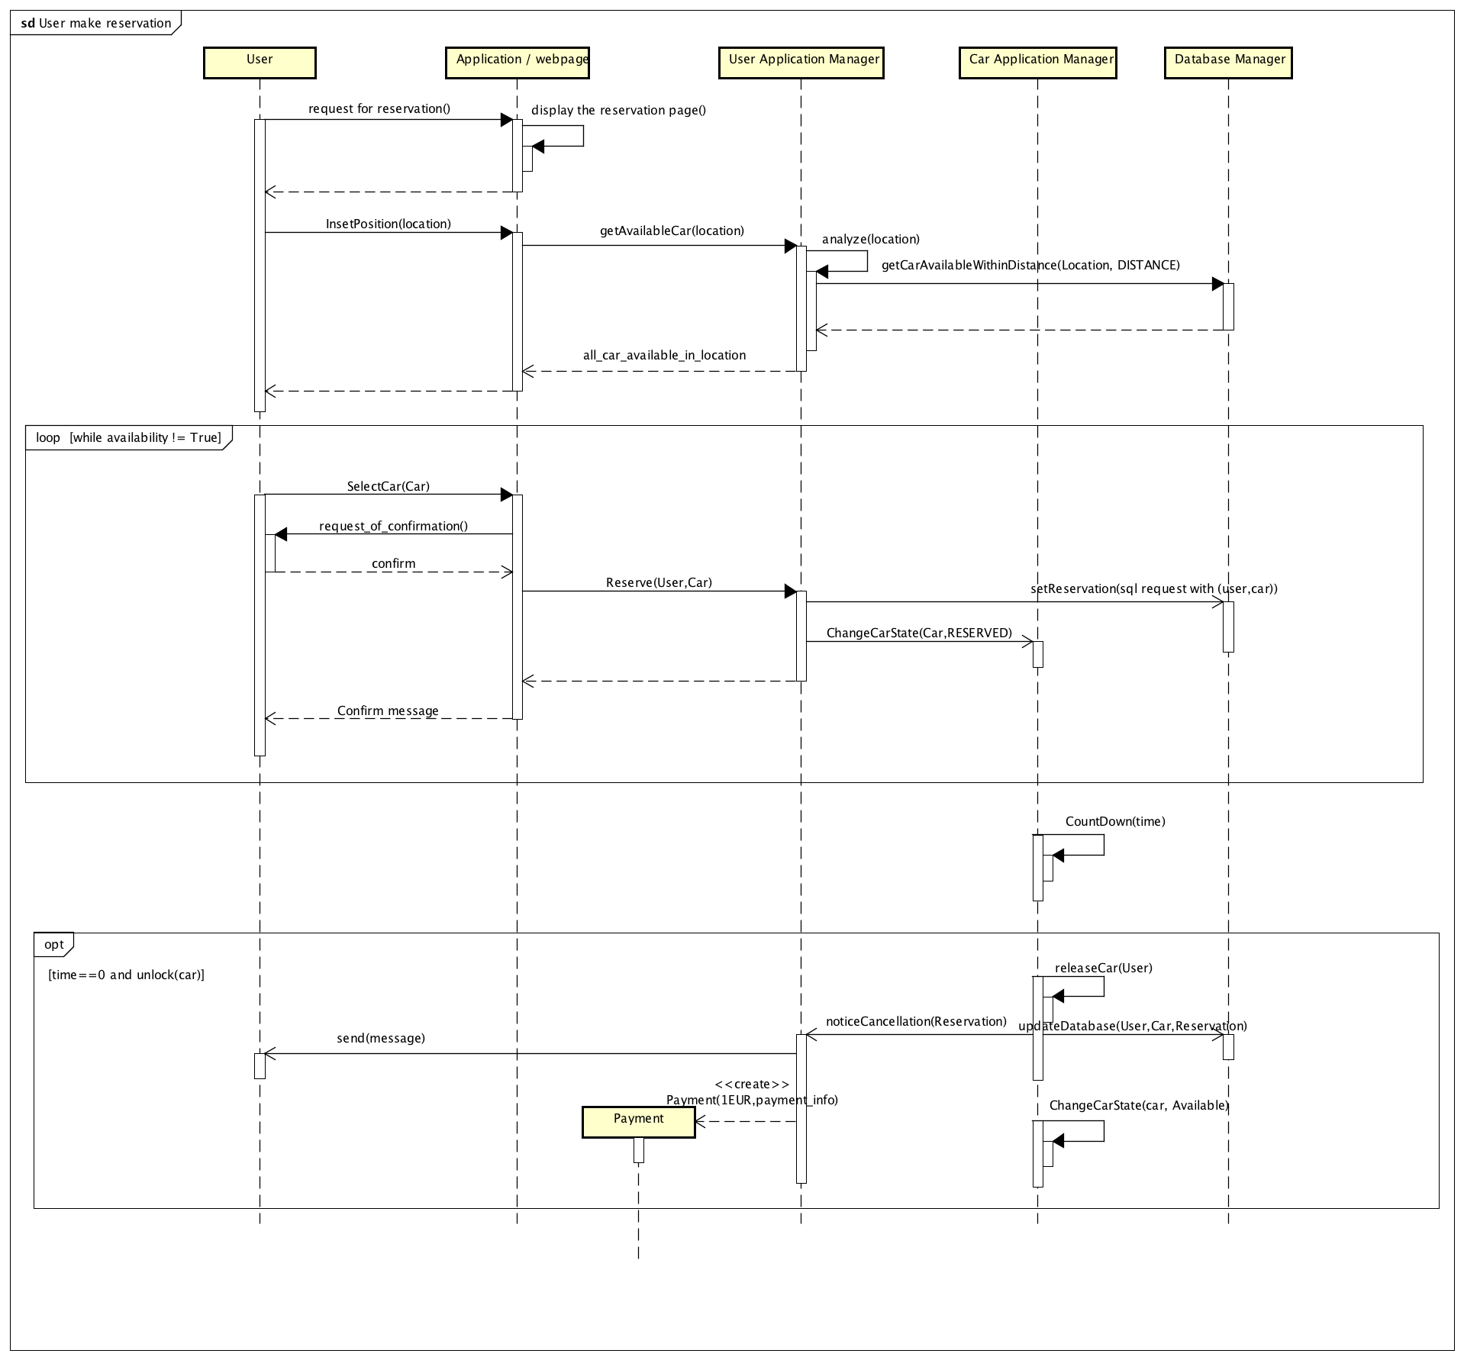
Reserve

Slide 10
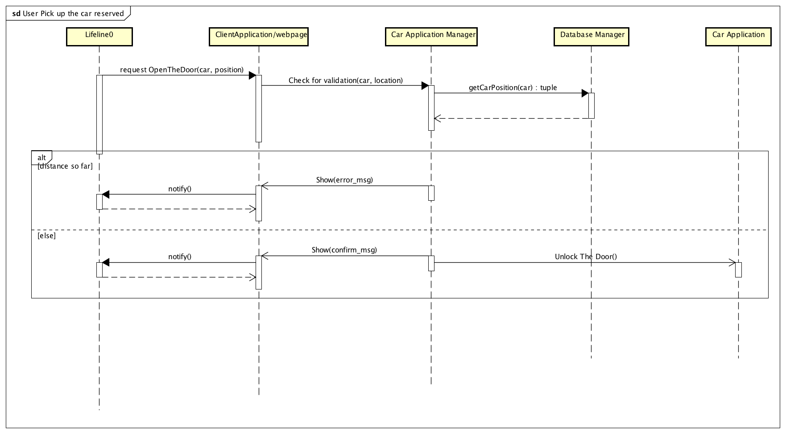
OpenTheDoor

Slide 11
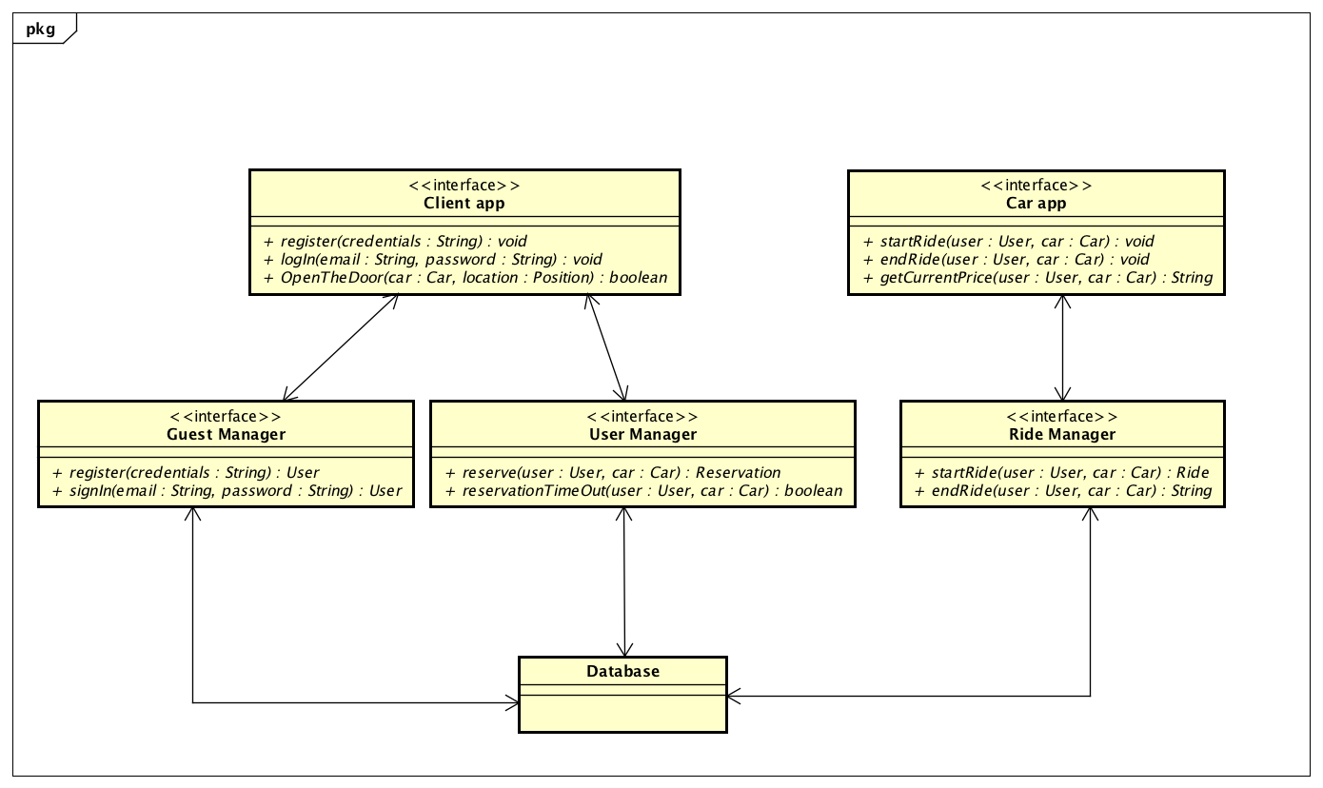
Component Interfaces

Slide 12
Selected architectural styles and patterns
presentation tier : It contains Client app and Car app. It is the layer that directly interacts with the actors.
business tier : Business tier contains all the logic. It manages re- quest and response. Also it manages the data interaction with the database. By using the business tier, clients do not directly interact with the database.
data tier : We use MySQL database to store all the useful data.

Slide 13
Pattern
Request-response Our system is based on service which uses request- response methodology. All the requests are generated from the user side which can be either a user application or a cat application. Server is responsible for processing the request and sending back the response.
MVC Model-View-Controller is used in our system. To combine it with our three-tier architecture, the view part lies on the client app side which deals with interaction with users. Model and Controller are in the server side, which maintains business logic and manipulation of data.

Slide 14
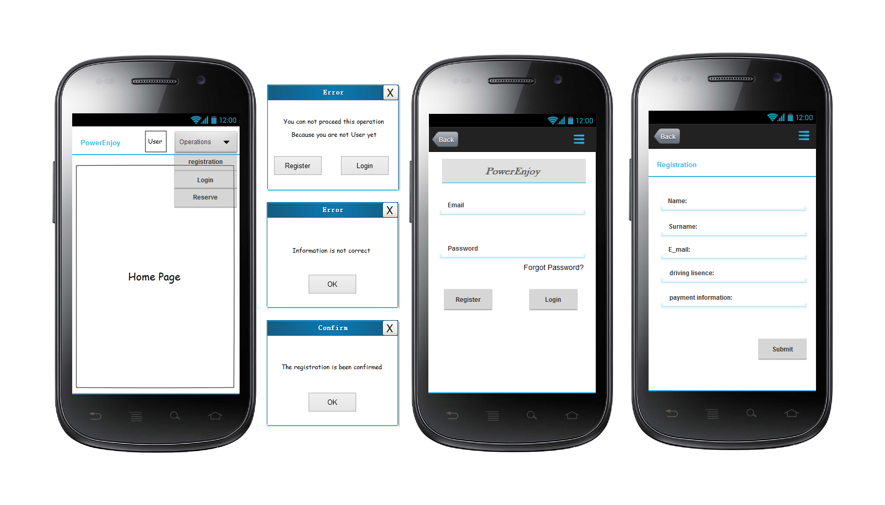
User Interfaces

Slide 15
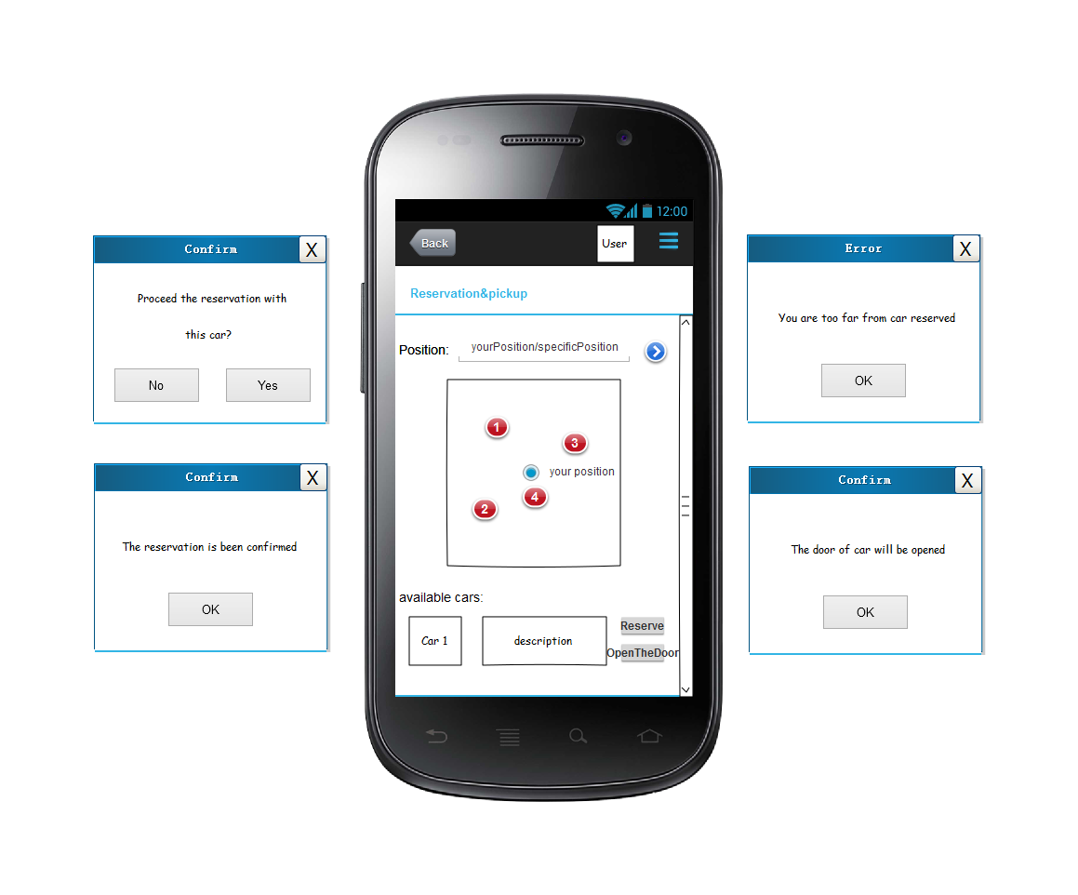

Slide 16
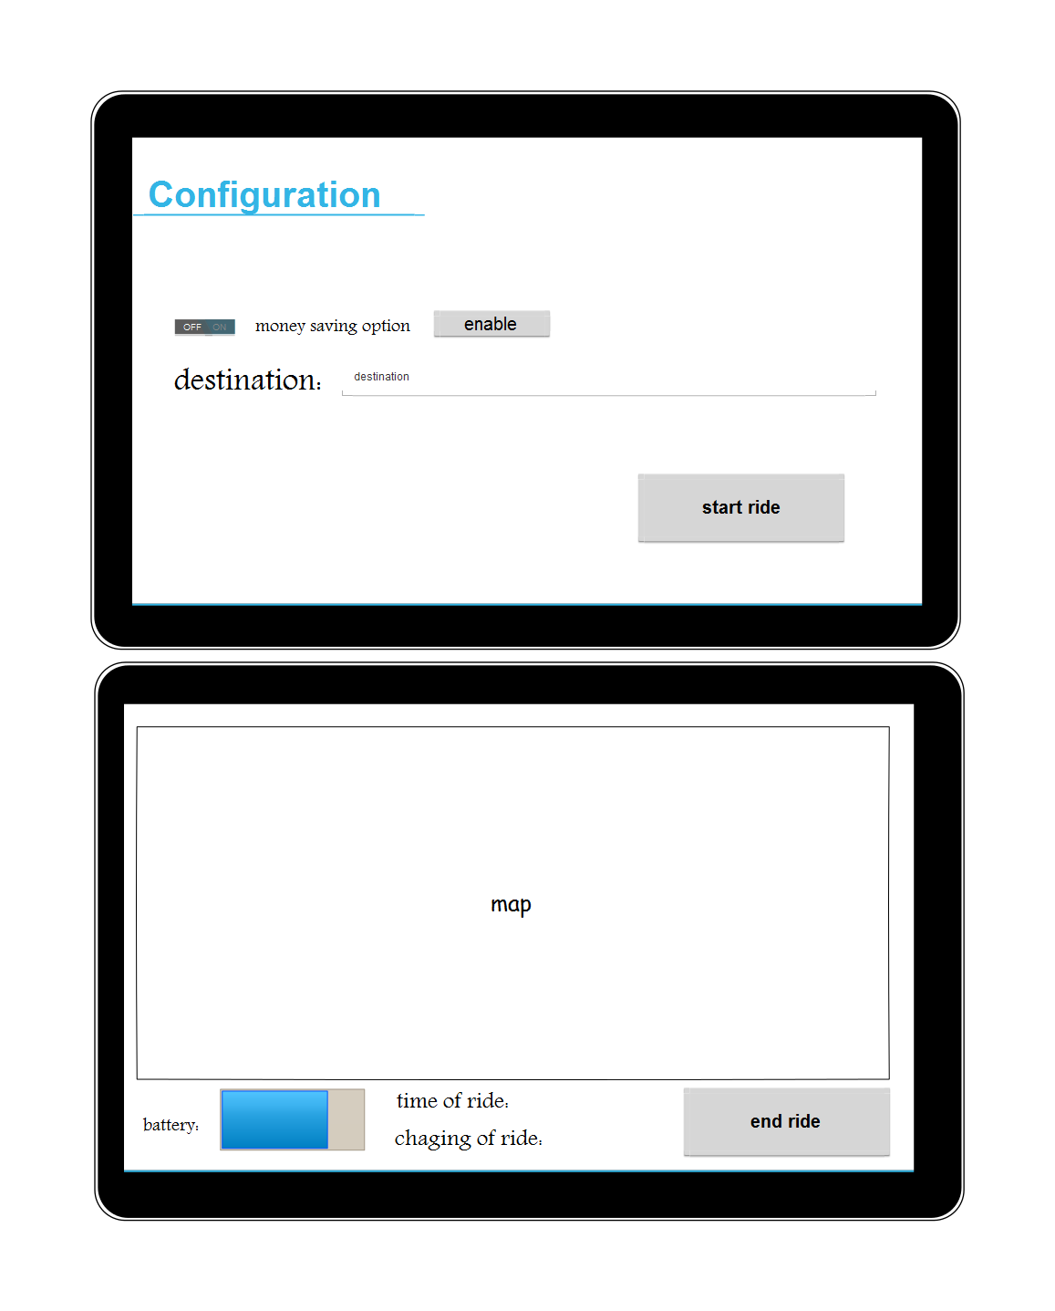

Slide 17
Thank you
Q & A

